Slide 1

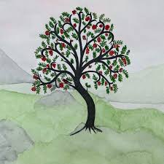
Welcome to Rowan Class
Meet the Teacher
Miss Wilson, Mrs Staniforth Ms Stevens

Slide 2
What a fantastic start to term!
All the children have made a fabulous start to the term, adapting quickly to the new routines. In return we are all making sure we catch these wonderful behaviours and are rewarding the children with house points! Our other class rewards include Star of the Week, Academic Star and Star of the day to name just a few! We are all committed to maintaining a positive atmosphere to learn in and hope you have felt this too.

Slide 3
Daily reading
As you know we hope for the children to be reading every night at home where possible. Please support us by encouraging your child to read, talking about the story and recording their reading.
Notes:
A child who reads for 20 minutes a day is exposed to 1.8 million new words in just one year. Discussing a book or story is really important. It shows that reading is not a solitary activity and that they can generate really interesting conversations. Having these discussions shows that there are many different ways to look at a story, which is a really important skill that they will need for future learning.

Slide 4

Spelling
Every Monday your child will be taught a new set of words. These will be checked on a Friday. All the weekly spellings follow a rule and the check will include two extra words which follow the same rule to ensure understanding.
Please encourage your child to practise for 10 minutes daily on spelling shed.

Slide 5

Times Tables
Recall of the times tables is important and underpins maths achievement throughout education. Children will be given access to Times Tables Rock Stars and should practise at home for 5 mins each day. The Garage game mode is specifically designed to train the children through the tables in the order they are taught to boost their progress.

Slide 6

Homework
As well as Reading, TTRS and Spellings the children will be given a homework task each Friday linking to something we have been doing in class. This will usually be Maths or English focused and should take no more than 30 minutes. Homework is due back on the Wednesday.
Homework will primarily be set online via either spag.com or maths.co.uk. Please support your child with their homework by ensuring they have access to these websites to complete their work.

Slide 7

PE Days
Rowan Class have PE on Monday and Wednesday. Please come to school in named PE kits.
For health and safety reasons long hair should be tied back in school but particularly in P.E.
Pierced earrings should be removed for PE. If your child can’t take out their own earrings, please remove them before school on those days.

Slide 8

Forest School
Rowan Class will have Forest School on alternate Fridays. As the weather becomes more unpredictable, please ensure your child has a pair of wellies and a warm coat / waterproof for both Forest School and for playtimes on the field.
Please name everything.

Slide 9
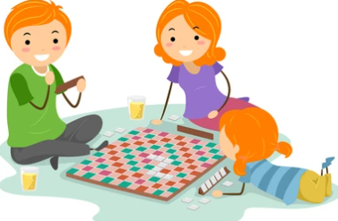
How to help at home
There are lots of opportunities to help children with their Maths skills at home.
Let them handle coins, practice telling the time on an analogue clock and discuss simple problems using these skills. Play games with dice and playing cards.
Read to your child regularly. The benefits of reading to children include developing their vocabulary, language skills and literacy, building their empathy and helping them learn how to handle challenging feelings.
Exposure to a broad range of stories will help to further strengthen your child’s writing ability.

Slide 10
A few brief reminders
Please send your child into school with a water bottle every day, with just water in. We encourage the children to drink throughout the day.
Please send your children into school with clips to keep their hair from falling in front of their eyes and tie long hair back.
Please name all of your child’s uniform! This includes renaming any uniform passed down from friends.
Children in KS2 can bring in a healthy snack from home for break time. No fizzy drinks, crisps or chocolate are allowed at either break or lunch time.
If earrings are worn, they must be studs.

Slide 11


Online safety
Online safety is a big focus for us across the school. We will be covering how to be safe on the internet in our PSHE lessons during the year, however, access to the internet is something which takes place in the home.
Please ensure that children are being monitored on the internet and are only accessing age appropriate material. Parental controls within apps and features such as Guided Access on IPads are a great way to ensure you are aware of what your children are accessing.

Slide 12
How we stay in touch
The class newsletter comes out at the start of each half term giving you information on what we will be learning and any key dates coming up.
The class page on the website is updated regularly with English model texts, current knowledge organisers for Science and Humanities and other useful information.
Open classroom is usually the first Monday of the month from 2:45pm and gives you a chance to come in and see what we have been doing first hand.

Slide 13

Worries or concerns?
Please use the Class Teachers or TA as your first port of call with any problems or concerns (large or small). We are usually best placed to deal with your queries, and you can catch us in the playground at the end of each day.
Rest assured – your children are all settling beautifully, working well and adapting to the new routines of Year 5.
Thank you for coming.

