Slide 1
Welcome to Willow Class Meet the Teacher
Miss Pellow & Mr James

Slide 2
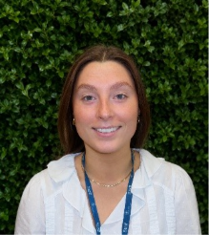
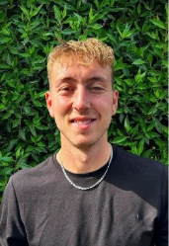
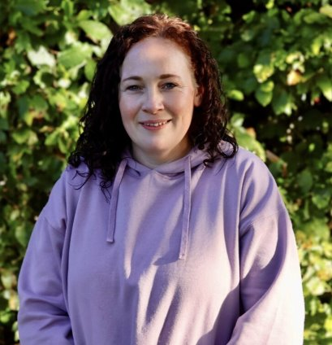
Staff in Willow Class
Miss Pellow: Class Teacher
Mr James: TA
Miss Gosden: PPA cover Thursday pm

Slide 3

What a fantastic start to term!

Slide 4
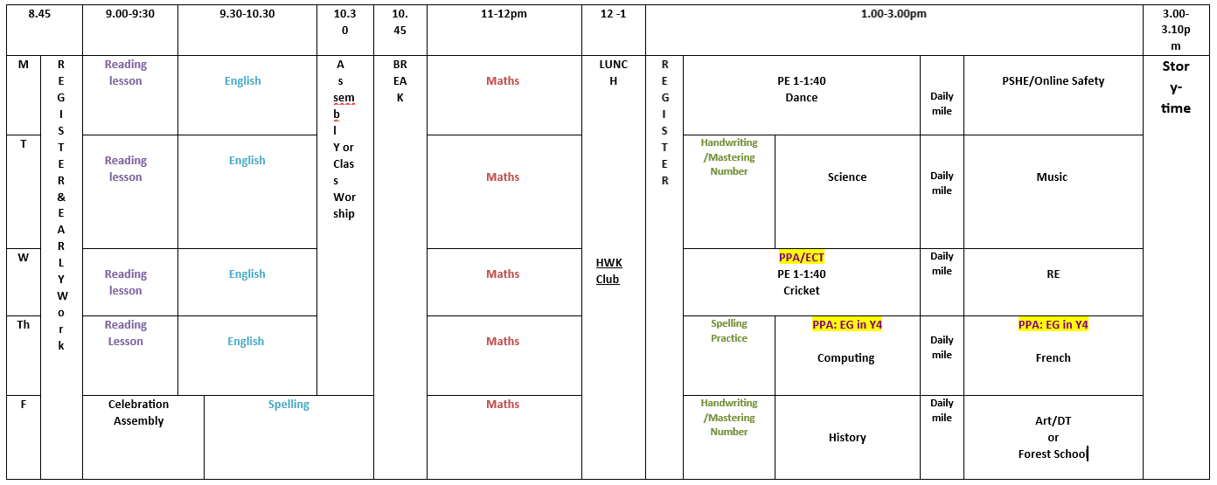
A typical week in Willow Class

Slide 5

Daily reading
Reading at home every day is one of the most valuable ways to support your child's learning.
Please encourage your child to read regularly, discuss the book or story with them, and help them record their ideas, comments and reflections in their reading journal.

Slide 6

Spelling
Every Friday the children will have a spelling test and be taught a new set of ten words. These will be checked on the following Friday.
Please encourage your child to practice for 10 mins daily on Spelling Shed.
The children will also be given a weekly spelling homework sheet along with a 'Look, Say, Cover, Write, Check' activity to help them practice and consolidate their spellings at home.

Slide 7

Times Tables
Recall of times tables essential throughout KS2 in Y4 children are expected to develop fluency in all multiplication tables up to 12 x 12 and will take part in the Multiplication Tables Check (MTC).
Please ensure your child is practicing TTRS for 10 mins daily. The garage game mode is specifically designed to train the children through the tables in the order they are taught and is highly effective in boosting progress.

Slide 8

Homework
The children will be expected to read regularly at home, practice their times tables on TTRS and learn their weekly spellings.
Occasionally, children may be set an additional Maths or English task linked to something we have been learning in class. This homework will take no longer than 20 minutes to complete.
Homework will be set online using SPaG.com and Maths.co.uk

Slide 9

Online Safety
Online safety is a big focus for us across the school year. We will be covering how to be safe on the internet in our PSHE lessons during the year.
At home please ensure that children are being monitored on the internet and are only accessing appropriate material. Parental controls within apps and features such as Guided Access on iPads are a great way to ensure you are aware of what your children are accessing.

Slide 10

PE days
Willow class have PE/Games on Mondays and Wednesdays.
Please ensure your child comes into school in PE kit these days.
Long hair should always be tied up and any jewelry removed.

Slide 11
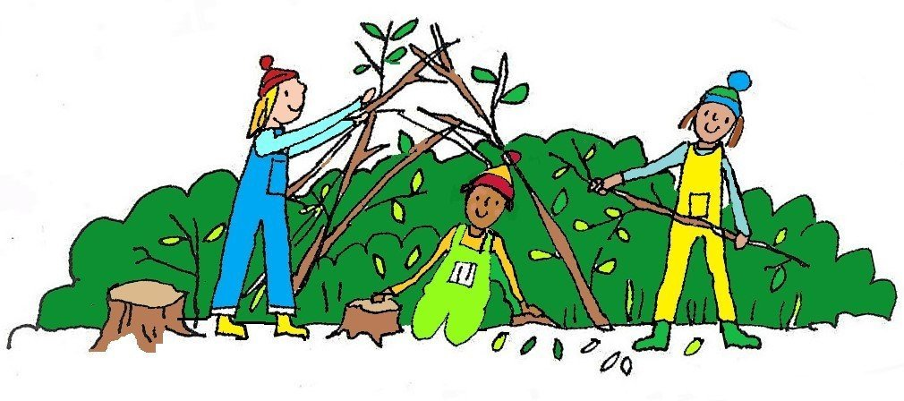
Forest School
Willow class will use forest school regularly throughout the year.
As the weather becomes more unpredictable, please ensure your child has a pair of wellies and a warm coat/waterproof for both Forest School and playtimes on the field.
Please name everything!

Slide 12

Some brief reminders
Please send your child into school everyday with a water bottle with just water.
We are a nut-free school.
Please name your child's uniform clearly, including renaming any uniform passed down from friends.
All children have a healthy snack provided each day. No fizzy drinks, crisps or chocolate are allowed at break or lunch time.

Slide 13
How to stay in touch
The class news letter comes out at the start of each half term giving you information on what we will be learning and any key dates coming up.
The class page on the school website is updated regularly with English model texts, current knowledge organisers for Science and Humanities and other useful information.
Open classroom is usually the first Monday of the month from 2:45pm this gives you a chance to come in and see what we have been doing first hand.

Slide 14

Any questions or concerns
Please use the Class Teachers or TAs as your first point of call with any problems or concerns (large or small). We are usually best placed to deal with your queries and you can catch us at pick-up at the end of the day.
Rest assured – your children are settling in beautifully, working hard and adapting to the new routines of Year 4.

